Slide 1
Turbine Performance Prediction
Power Curve Working Group
9 December 2015
Neil Atkinson, Matthew Colls, Joel Manning

Slide 2
About Prevailing
Wind farm analysis specialists
1000+ wind farms analysed in 20 countries
Clients: developers, investors and owners
Pre-construction and operational wind farms
18 staff based in UK, Germany and USA

Slide 3
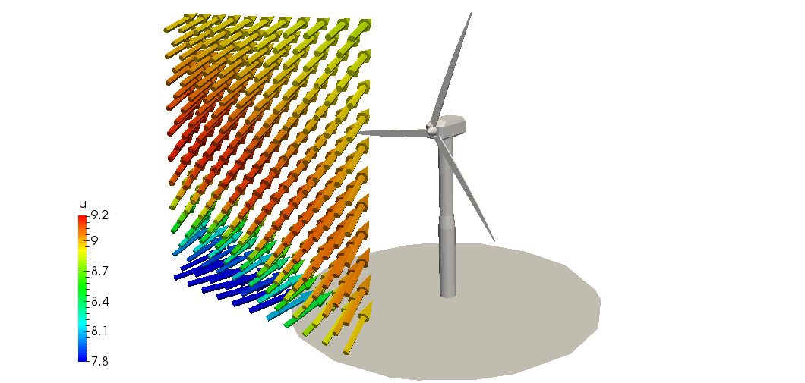
Context
Parameterised models are inherently limited by the parameter choice.
More parameters is one answer, but the matrix can get thin.
What if we attempt to simulate turbine performance more directly?
Increasingly relevant as conditions are better known (LiDAR, CFD etc.)

Slide 4
Two parallel approaches
Empirical: Performance matrix based on power performance test data
Theoretical: Simple blade element model of a wind turbine.

Slide 5
Empirical: Choice of binning parameters
Turbulence intensity
Rotor wind speed ratio (actually across ¾ diameter)
Normalised wind speed
U_{top}
RWSR = U_{top}/U_{bottom}
U_{bottom}

Slide 6
Empirical: Data
Turbine power performance test data
Resulting 3D turbine performance matrix
47 turbines
8 turbine types
4 manufacturers
Turbulence intensity
USA
Asia
Europe
Rotor wind speed ratio
Broad range of site conditions
Normalised wind speed

Slide 7
Empirical: 3D Performance Matrix
Veer?
Inflow angle?
Shear relaxation?
U_{norm} = 0.7
Turbulence intensity
 | 2% | 4% | 6% | 8% | 10% | 12% | 14% | 16% | 18% | 20% | 22% | 24%
1.7 | 79% | 78% | 83% | 80% | 88% | 88%
1.6 | 79% | 82% | 85% | 87% | 90% | 89% | 90%
1.5 | 79% | 84% | 87% | 91% | 91% | 90% | 91% | 93% | 92% | 93%
1.4 | 80% | 86% | 88% | 91% | 94% | 96% | 96% | 96% | 95% | 99%
1.3 | 81% | 85% | 89% | 91% | 95% | 98% | 98% | 97% | 100% | 100% | 102% | 95%
1.2 | 81% | 88% | 90% | 92% | 96% | 98% | 100% | 100% | 102% | 104% | 103% | 106%
1.1 | 77% | 87% | 91% | 94% | 97% | 99% | 102% | 103% | 105% | 107% | 107% | 109%
1.0 |  | 89% | 93% | 96% | 98% | 100% | 101% | 104% | 105% | 105% | 111% | 103%
0.9 |  |  |  |  |  |  | 94% | 95% | 95% | 96% | 102%
0.8 |  |  |  |  |  |  | 90% | 93% | 92% | 95% | 97%
0.7 |  |  |  |  |  |  | 88% | 89% | 92% | 90% | 94%
No data
Rotor wind speed ratio
Inner Range
No data

Slide 8
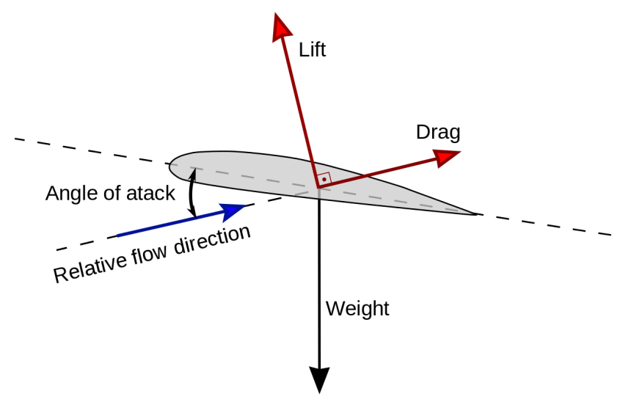
A Theoretical Approach
Hypothesis:
Turbine performance variations are primarily related to blade aerodynamic performance variations.
Optimal
Performance
Stall
LDR
AOA

Slide 9
Theoretical: Introduction
Simple theoretical model of a wind turbine
Model turbine performance for any given wind conditions?
C_{L}
C_{D}
Real blade section wind tunnel test data

Slide 10
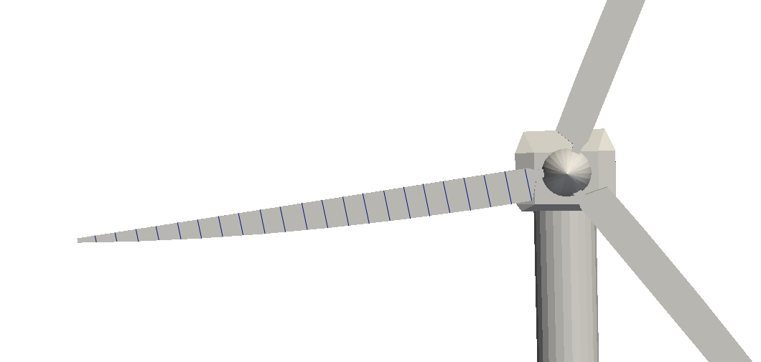
Theoretical: Model Description
Simplified blade element approach
Calculate torque for each blade section
Torque/RPM control loop
Any arbitrary input wind conditions
Calculate variation in power output from ideal conditions
u
v
w

Slide 11
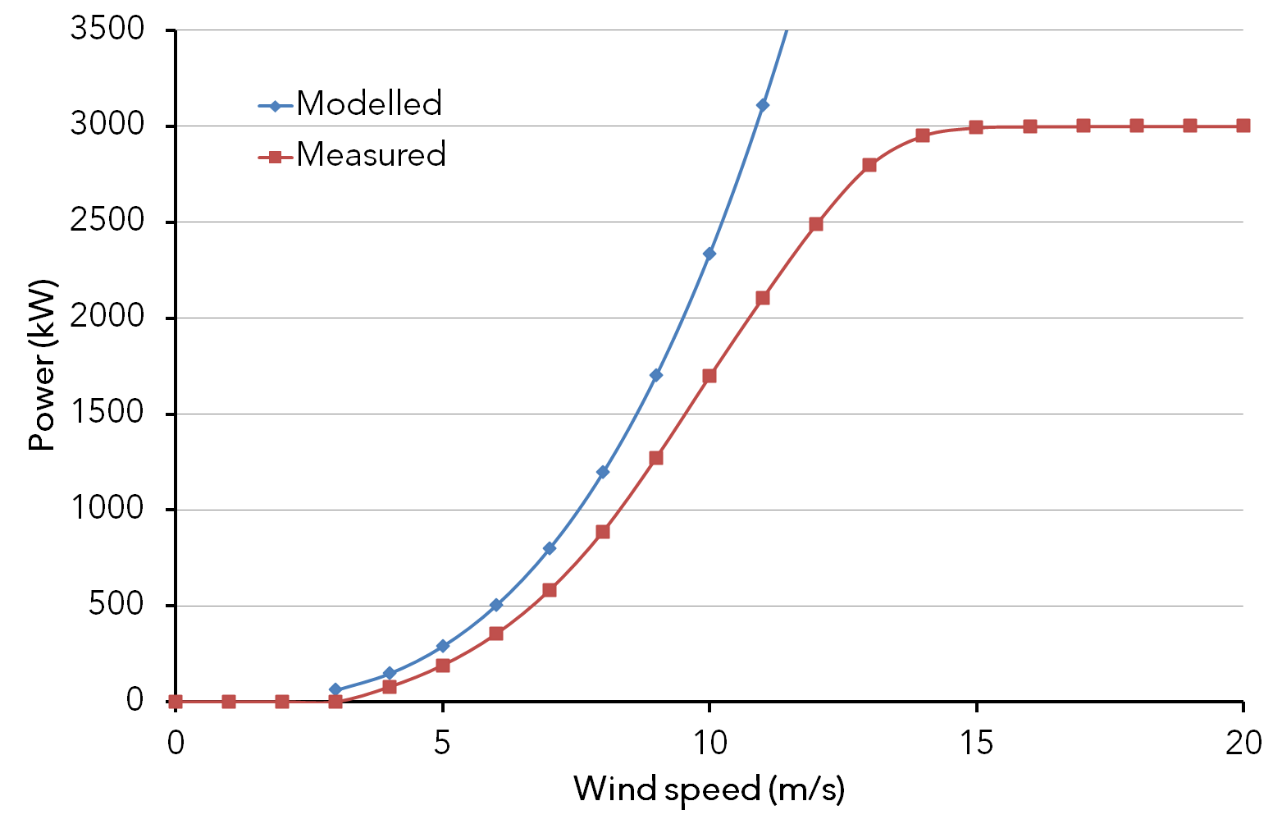
Results – Power Curve
Gap is due to inefficiencies missing from the model
No consideration of pitch variation

Slide 12
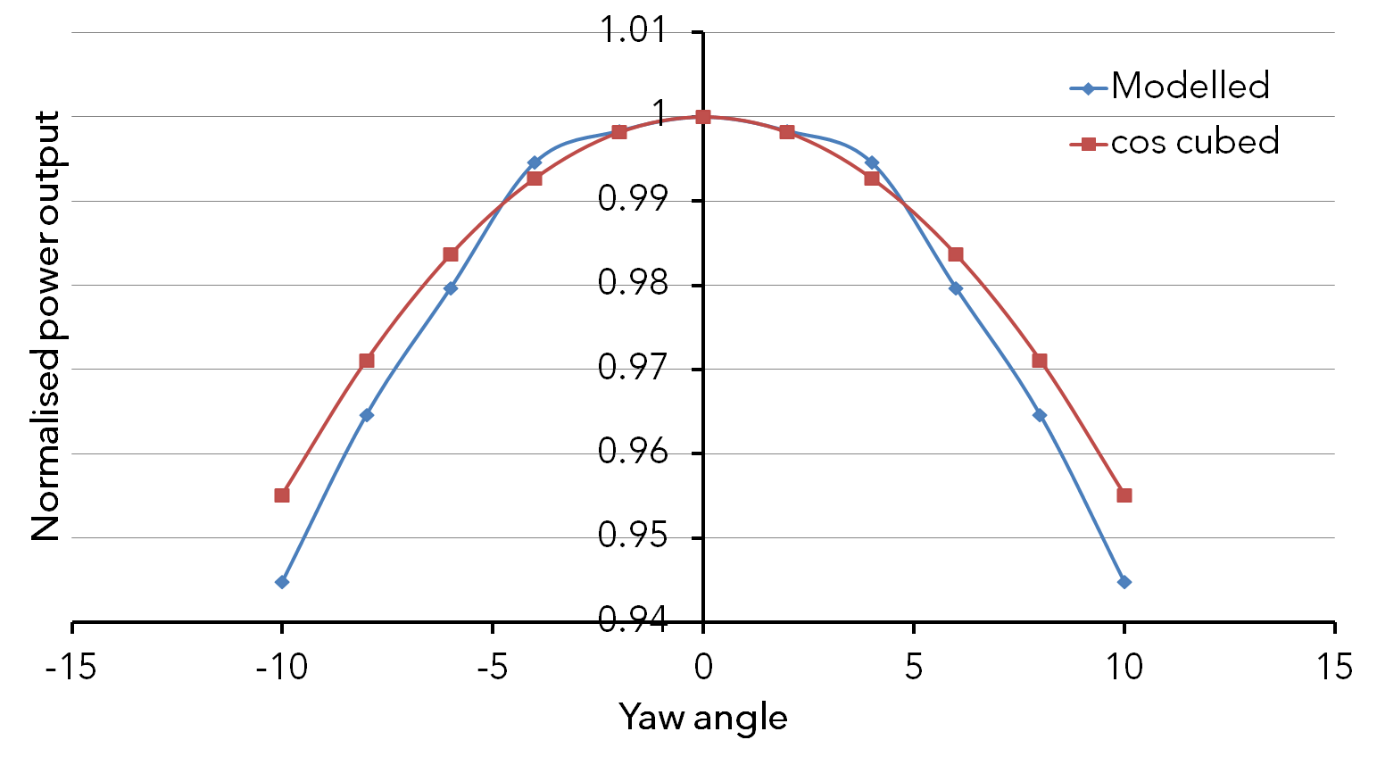
Theoretical: Yaw Error Results

Slide 13
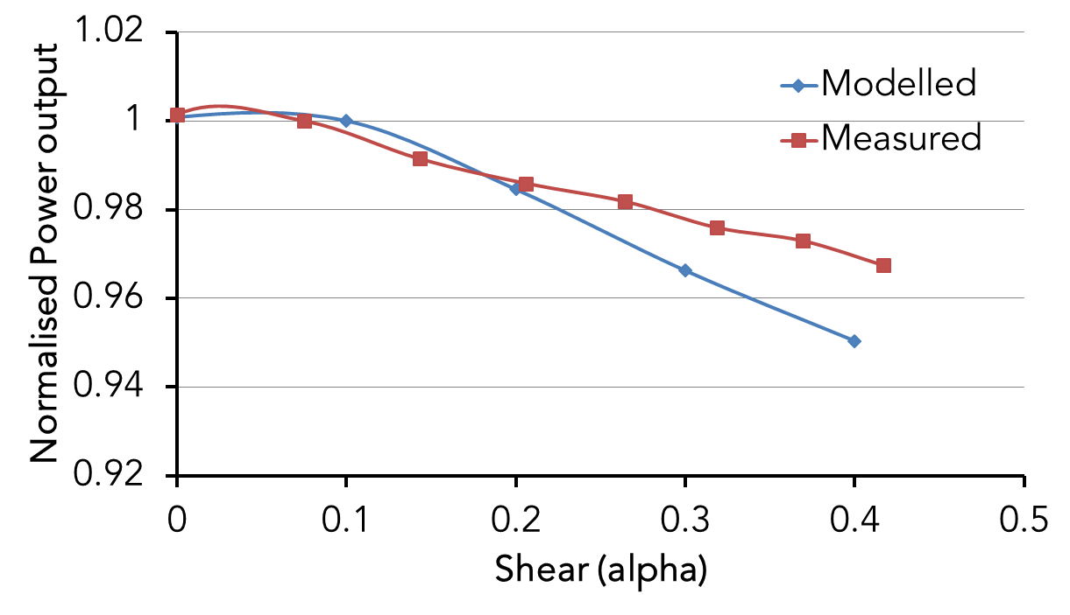
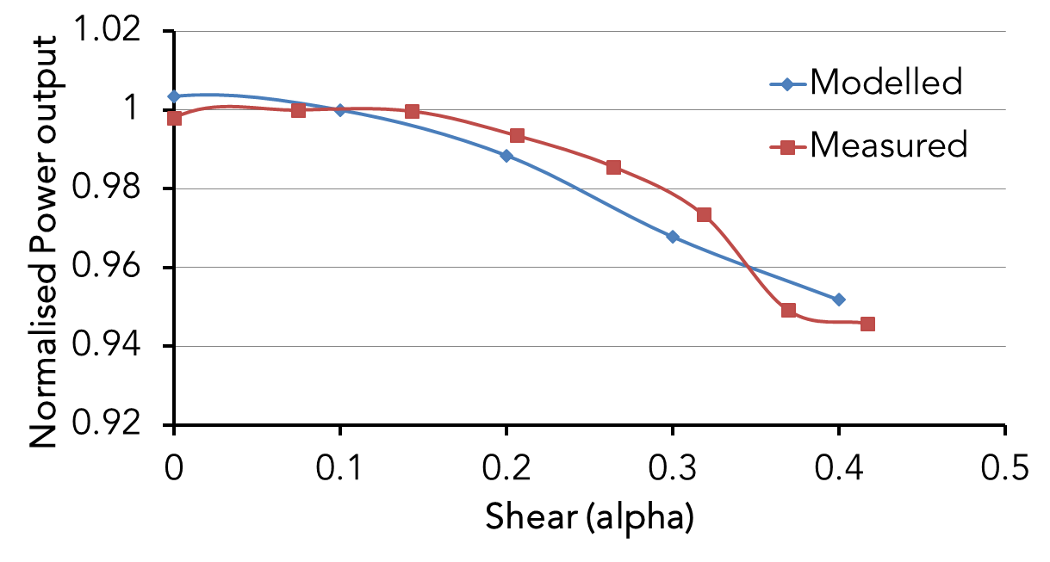
Theoretical: Shear Variation Results
6 m/s
8 m/s

Slide 14
Next Steps
What about turbulence and wind speed axes?
Combining observation and simulation
Tie back to PCWG process, and consensus contribution.

Slide 15
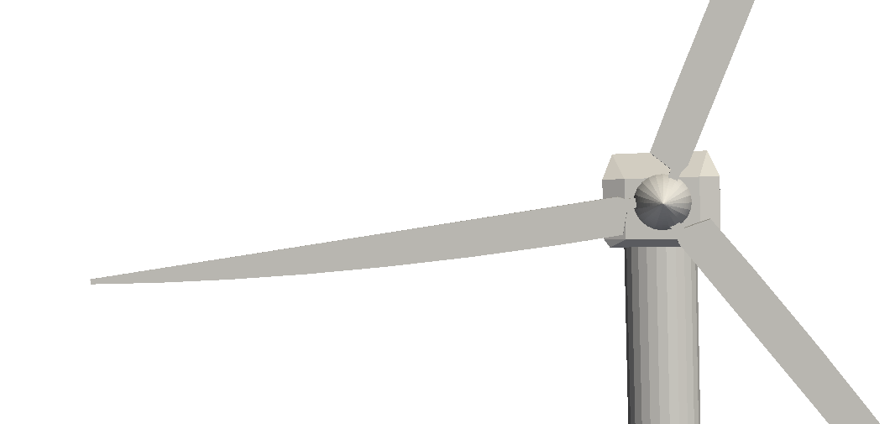
Conclusions
Pre-construction energy yield assessment
Site measurements
or
CFD wind field
Composite performance model
Turbulence intensity
Turbine performance matri(x/ces)
Improved turbine performance estimates
Normalised wind speed
Rotor wind speed ratio
Simple theoretical turbine model
Notes:
A simple blade element model enables real turbine performance predictions over a wider range of conditions
Model shows good agreement with real performance data

Slide 16
Thank you
Free analysis* if you share your raw power curve test data with us!
matthew.colls@prevailinganalysis.com
www.prevailinganalysis.com

